Slide 1

Credit Risk Modeling
Nhat Huynh
Alvaro Rodriguez
Benedikt Schmidt
Carsten Stahl

Slide 2

Suppose you run a bank…
What is the probability for a client to run bankrupt?
How big is the loss per client?
What is the loss of the bank?

Slide 3

Our Mission
Predict the Expected Loss of a bank by training models for…
Probability of
Default
Loss given Default

Slide 4

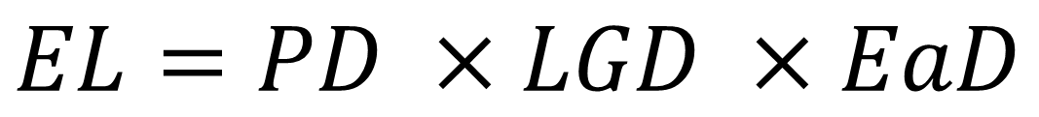
The Expected Loss Equation [1]
$$EL=PD ×LGD ×EaD$$
?
Probability of
Default
Loss given
Default
Exposure at
Default
*we modeled a simplified equation. The source models the EL for each payment-period

Slide 5

The Expected Loss Equation
$${\hat{EL}}_{client}=\hat{PD} ×\hat{LGD} × EaD$$
Random Variables
Deterministic
*we modeled a simplified equation. The source models the EL for each payment-period

Slide 6
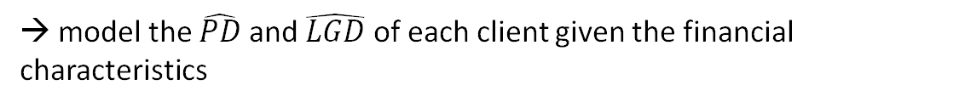
The Expected Loss Equation
$${\hat{EL}}_{client}=\hat{PD} ×\hat{LGD} × EaD$$
Random Variables
Deterministic
→ model the $\hat{PD}$ and $\hat{LGD}$ of each client given the financial characteristics
*we modeled a simplified equation. The source models the EL for each payment-period

Slide 7
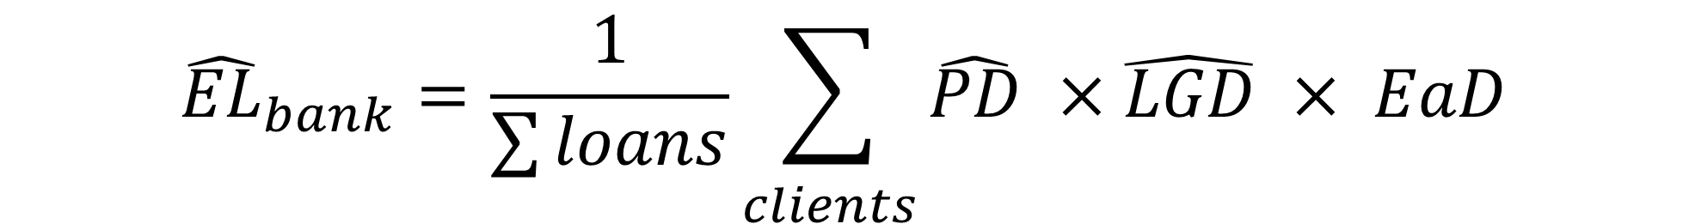
The Expected Loss Equation
$${\hat{EL}}_{bank}=\frac{1}{\sum{loans}}\sum_{\begin{aligned} \\ clients\end{aligned}}{\hat{PD} ×\hat{LGD} × EaD}$$

Slide 8

Lending Club dataset
Peer to Peer credit company in the US
Data contains features of the clients like [2]
Income / DIT
Fico Score
Employment situation
Mortgage
Recovery Rate
Etc.

Slide 9
Lending Club dataset
Income / DIT
Income / DIT
Employment situation
Fico Score
Mortgage
Etc.
Input
Good / bad client
Recovery Rate
Target

Slide 10

Modelling $\hat{PD}$ and $\hat{LGD}$
2. Exploratory Data Analysis (EDA)
4. Model Evaluation and Comparison
1. Data cleaning & processing
3. Model building

Slide 11


1. Data Cleaning and Processing
Threshold for less rich features
Removing / replacing NA’s
Handling outliers (IQR)
Create dummy variables
Define target variable (“good or bad client?”, “recovery rate”)
Transform continuous features into categorial ones
Correlation between features (independency assumption)

Slide 12
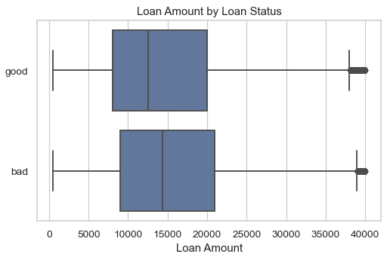
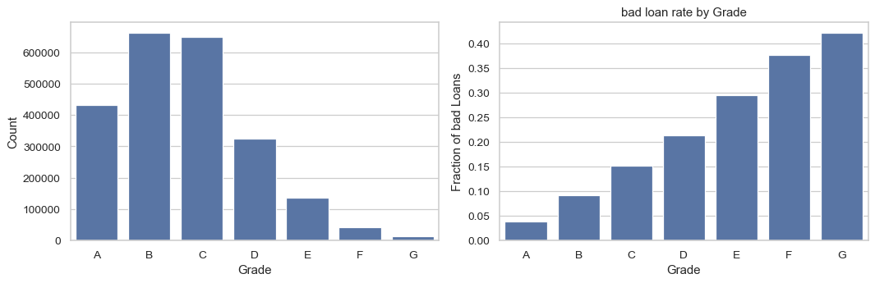
2. EDA
Exploring distributions of the characteristics
Visualizing correlations between features and target variables
Figure 1: Loan Amount By Loan Status
Figure 2: Grade by Loan Status

Slide 13
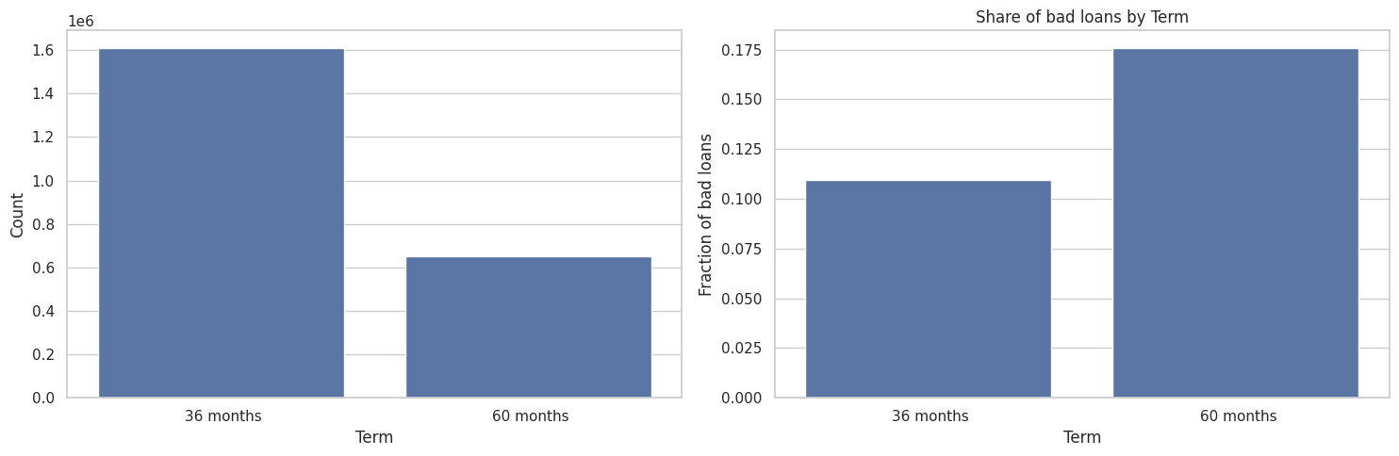
2. EDA: Term
Figure 3: Longer Term → higher chance of a bad loan

Slide 14
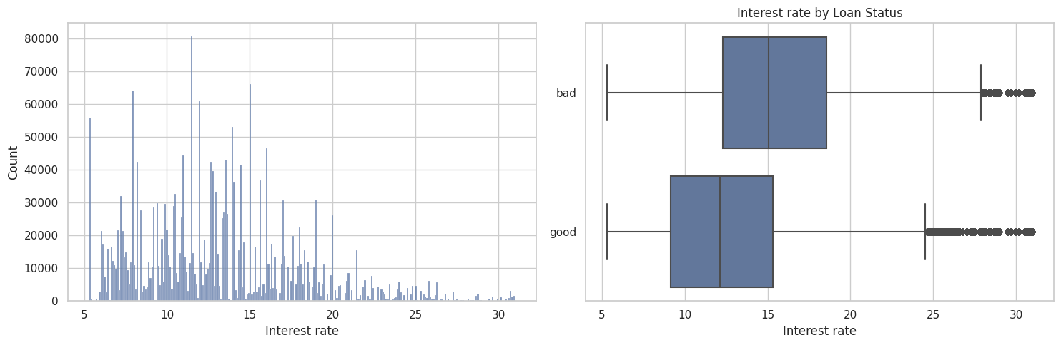
2. EDA: Interest rate
Figure 4: Higher interest rate is associated with a higher chance of a bad loan

Slide 15
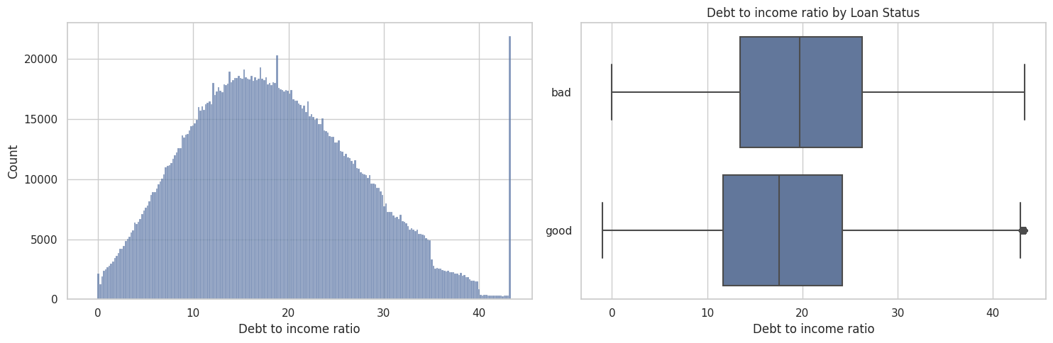
2. EDA: Debt to income ratio
Figure 5: Higher DTI is associated with a higher chance of a bad loan

Slide 16
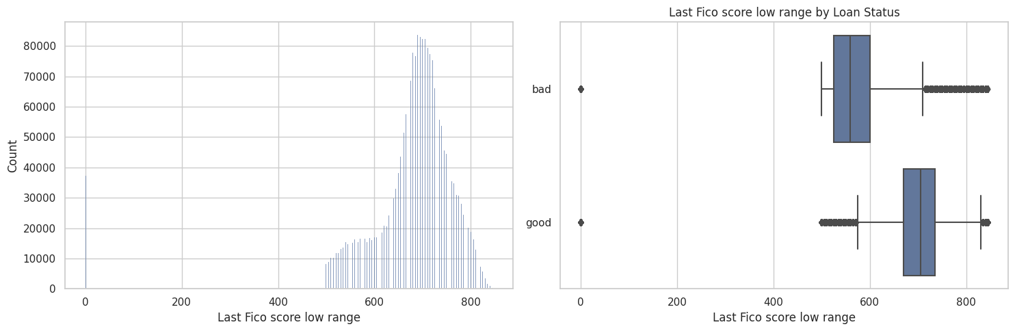
2. EDA: Fico Score
Figure 6: Lower Fico score is associated with a higher chance of a bad loan

Slide 17
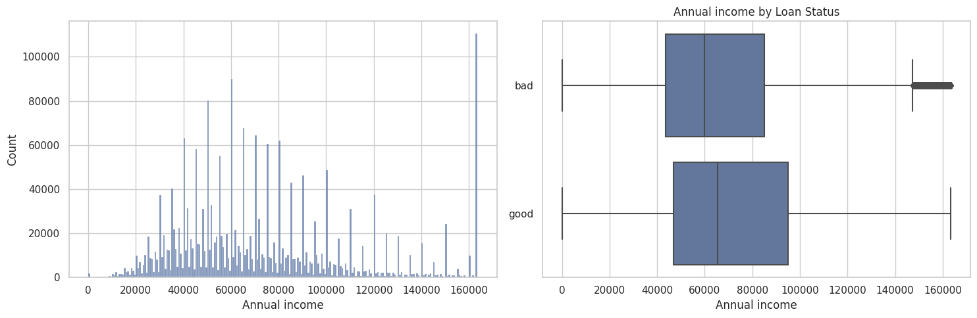
2. EDA: Annual income
Figure 7: Lower annual income is associated with a higher chance of a bad loan

Slide 18
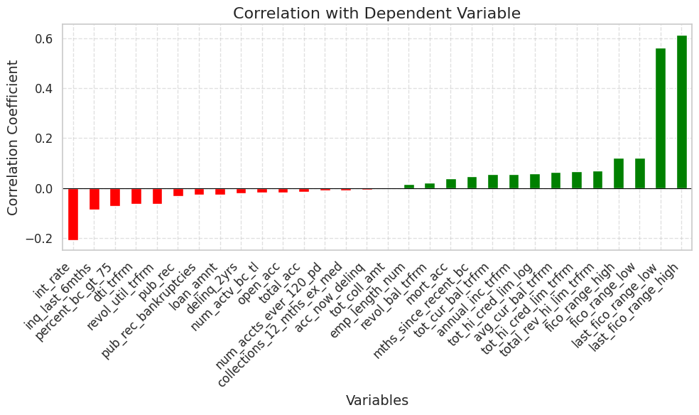
2. EDA: Correlation
High fico → good loan
High interest → bad loan
Employment length did not contribute
A lot of borrowers had 10+ years
Figure 8: Correlation between independent features and dependent feature “good_bad”

Slide 19
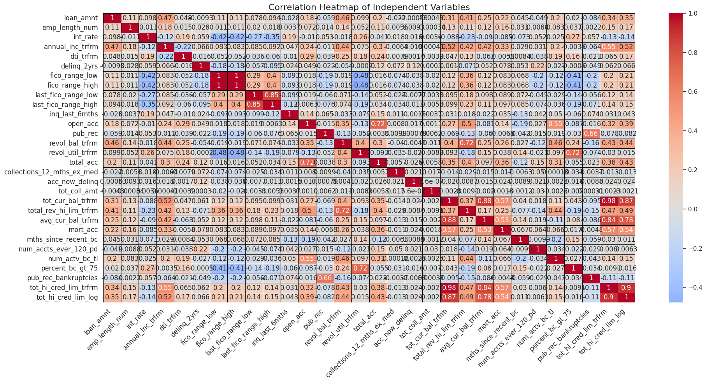
2. EDA: Correlation
Figure 9: Correlation between independent features

Slide 20
3. Model Building [3]
Random Forest
Naive Bayes
Logistic Regression
XGBoost
Beta Regression

Slide 21

3. Model Building [3]
Logistic Regression
Model for binary classification using the logistic function
Assumes linearity
Simple
High structure
Interpretable
Application: PD
Random Forest
Naive Bayes
XGBoost
Beta Regression

Slide 22
3. Model Building [3]
Random Forest
Naive Bayes
Logistic Regression
XGBoost
Beta Regression

Slide 23
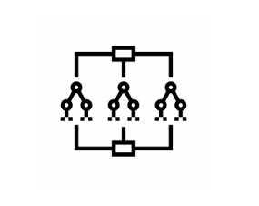
3. Model Building [3]
Random Forest
Non parametric model
Better handling of non-linearity
Application: PD
Naive Bayes
Logistic Regression
XGBoost
Beta Regression

Slide 24
3. Model Building [3]
Random Forest
Naive Bayes
Logistic Regression
XGBoost
Beta Regression

Slide 25
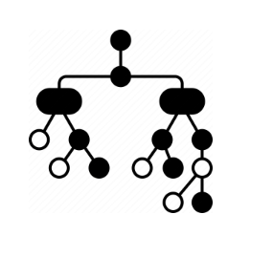
3. Model Building [3]
XGBoost
Random Forest
Ensemble method using gradient boosting of decision trees
Most sophisticated and complex method
Application: PD
Naive Bayes
Logistic Regression
Beta Regression

Slide 26
3. Model Building [3]
Random Forest
Naive Bayes
Logistic Regression
XGBoost
Beta Regression

Slide 27
3. Model Building [3]
Naive Bayes
Probabilistic classifier based on Bayes' theorem
Assumes independence among predictors
A little more complex than logistic regression
Application: PD
Random Forest
Logistic Regression
XGBoost
Beta Regression

Slide 28
3. Model Building [3]
Random Forest
Naive Bayes
Logistic Regression
XGBoost
Beta Regression

Slide 29
3. Model Building [3]
Random Forest
Naive Bayes
Logistic Regression
XGBoost
Beta Regression
Regression model for continuous proportion outcomes (in [0,1])
Application: LGD

Slide 30
3. Model Building [3]
Random Forest
Naive Bayes
Logistic Regression
XGBoost
Beta Regression

Slide 31
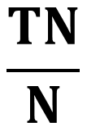


4. Evaluation Metrics
PREDICTED
 | Good Client PP | Bad Client NN
Good Client P | TP | FP
Bad Client N | FP | TN
Specificity
Recall
Precision
$$\frac{TP}{P}$$
$$\frac{TN}{N}$$
$$\frac{TP}{PP}$$
ACTUAL

Slide 32
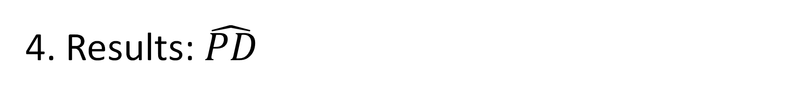
4. Results: $\hat{PD}$
/ | Logistic | Random Forest | Naive Bayes | XGBoost
Accuracy | 0.898 | 0.902 | 0.855 | 0.896
Recall | 0.903 | 0.911 | 0.854 | 0.895
Specificity | 0.866 | 0.836 | 0.857 | 0.901
Precision | 0.979 | 0.974 | 0.976 | 0.983
NPV | 0.567 | 0.581 | 0.464 | 0.559
AUC | 0.943 | 0.923 | 0.917 | 0.953
F1 | 0.940 | 0.942 | 0.911 | 0.938

Slide 33
4. Results: $\hat{PD}$
/ | Logistic | Random Forest | Naive Bayes | XGBoost
Accuracy | 0.898 | 0.902 | 0.855 | 0.896
Recall | 0.903 | 0.911 | 0.854 | 0.895
Specificity | 0.866 | 0.836 | 0.857 | 0.901
Precision | 0.979 | 0.974 | 0.976 | 0.983
NPV | 0.567 | 0.581 | 0.464 | 0.559
AUC | 0.943 | 0.923 | 0.917 | 0.953
F1 | 0.940 | 0.942 | 0.911 | 0.938

Slide 34
4. Results: $\hat{PD}$
/ | Logistic | Random Forest | Naive Bayes | XGBoost
Accuracy | 0.898 | 0.902 | 0.855 | 0.896
Recall | 0.903 | 0.911 | 0.854 | 0.895
Specificity | 0.866 | 0.836 | 0.857 | 0.901
Precision | 0.979 | 0.974 | 0.976 | 0.983
NPV | 0.567 | 0.581 | 0.464 | 0.559
AUC | 0.943 | 0.923 | 0.917 | 0.953
F1 | 0.940 | 0.942 | 0.911 | 0.938

Slide 35
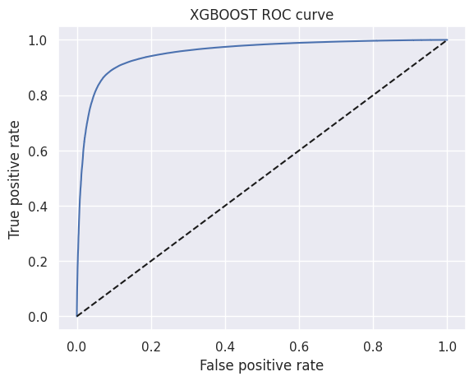
4. Results: $\hat{PD}$
/ | Logistic | Random Forest | Naive Bayes | XGBoost
Accuracy | 0.898 | 0.902 | 0.855 | 0.896
Recall | 0.903 | 0.911 | 0.854 | 0.895
Specificity | 0.866 | 0.836 | 0.857 | 0.901
Precision | 0.979 | 0.974 | 0.976 | 0.983
NPV | 0.567 | 0.581 | 0.464 | 0.559
AUC | 0.943 | 0.923 | 0.917 | 0.953
F1 | 0.940 | 0.942 | 0.911 | 0.938

Slide 36
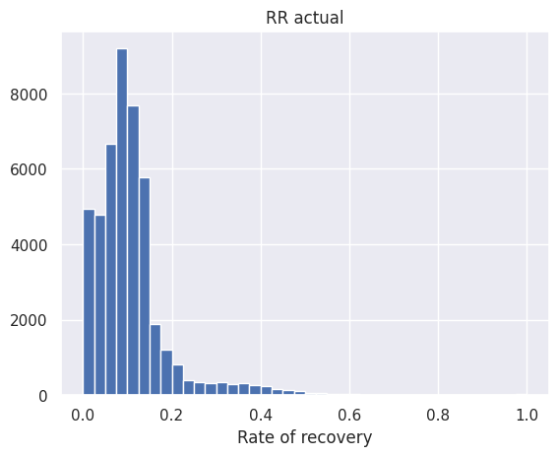
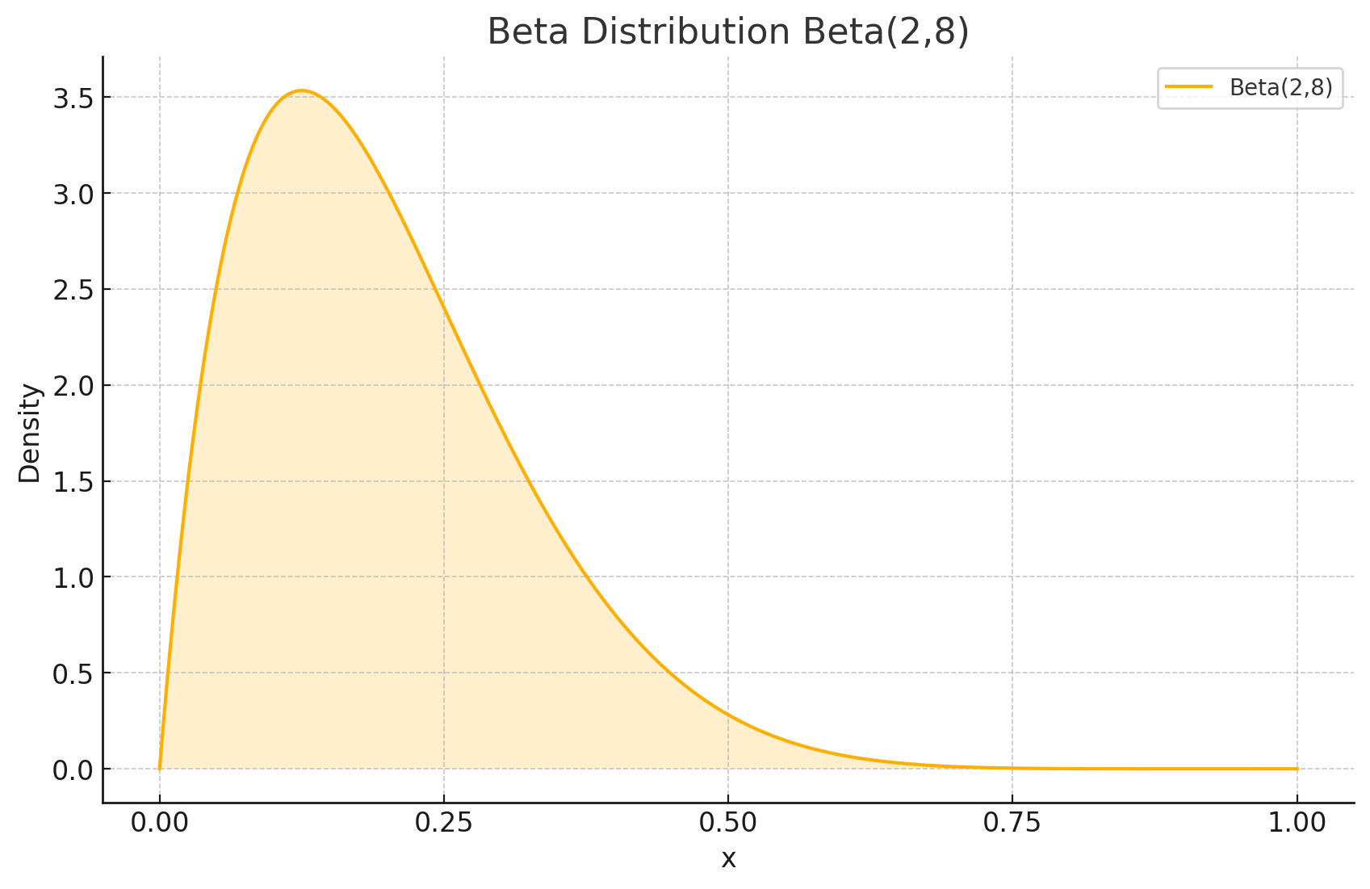
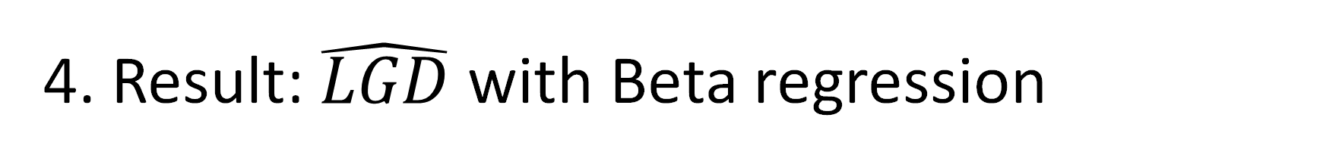
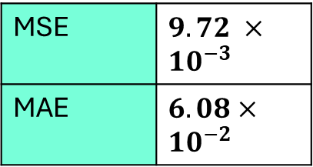
4. Result: $\hat{LGD}$ with Beta regression
LGD is constructed by Rate of recovery
Rate of recovery seems to be beta distributed
Therfore we use a beta-regression to model LGD
Has been used in literature aswell [2]
MSE | $9.72 ×{10}^{−3}$
MAE | $6.08×{10}^{−2}$

Slide 37

and finally…
$${\hat{EL}}_{bank}=6\%$$

Slide 38

Outlook
Incorporate the
interest rate
→Temporal dimension is missing
Improve XGBoost via
hyperparameters
Train complex
models like
XGBoost to predict LGD
Focus on under / overfitting

Slide 39
Thank You!
[1] Engelmann, Bernd. "Calculating lifetime expected loss for IFRS 9: Which formula is correct." SSRN Electronic Journal, May (2018).
[2] Jaber, Jamil J., et al. "Estimating Loss Given Default Based on Beta Regression." Computers, Materials & Continua 66.3 (2021).
[3] Xia, Yufei, et al. "Forecasting loss given default for peer-to-peer loans via heterogeneous stacking ensemble approach." International Journal of Forecasting 37.4 (2021): 1590-1613.

